Slide 1


Batch - 1: QUICK BOOKS
01
2023
Presented by
J.PUNEET –22R21A66985
K.MITHUN – 22R21A6686
K.MOUNESH – 22R21A6692
K.JOSEPH – 22R21A6697

Slide 2
Table of contents
01
02
03
Problem Statement
Customer Survey
Solution and Design
02
2023
TO MAKE USE OF OLD BOOKS
CREATING A E-COMMERCE TO SOLVE THE PROBLEM

Slide 3
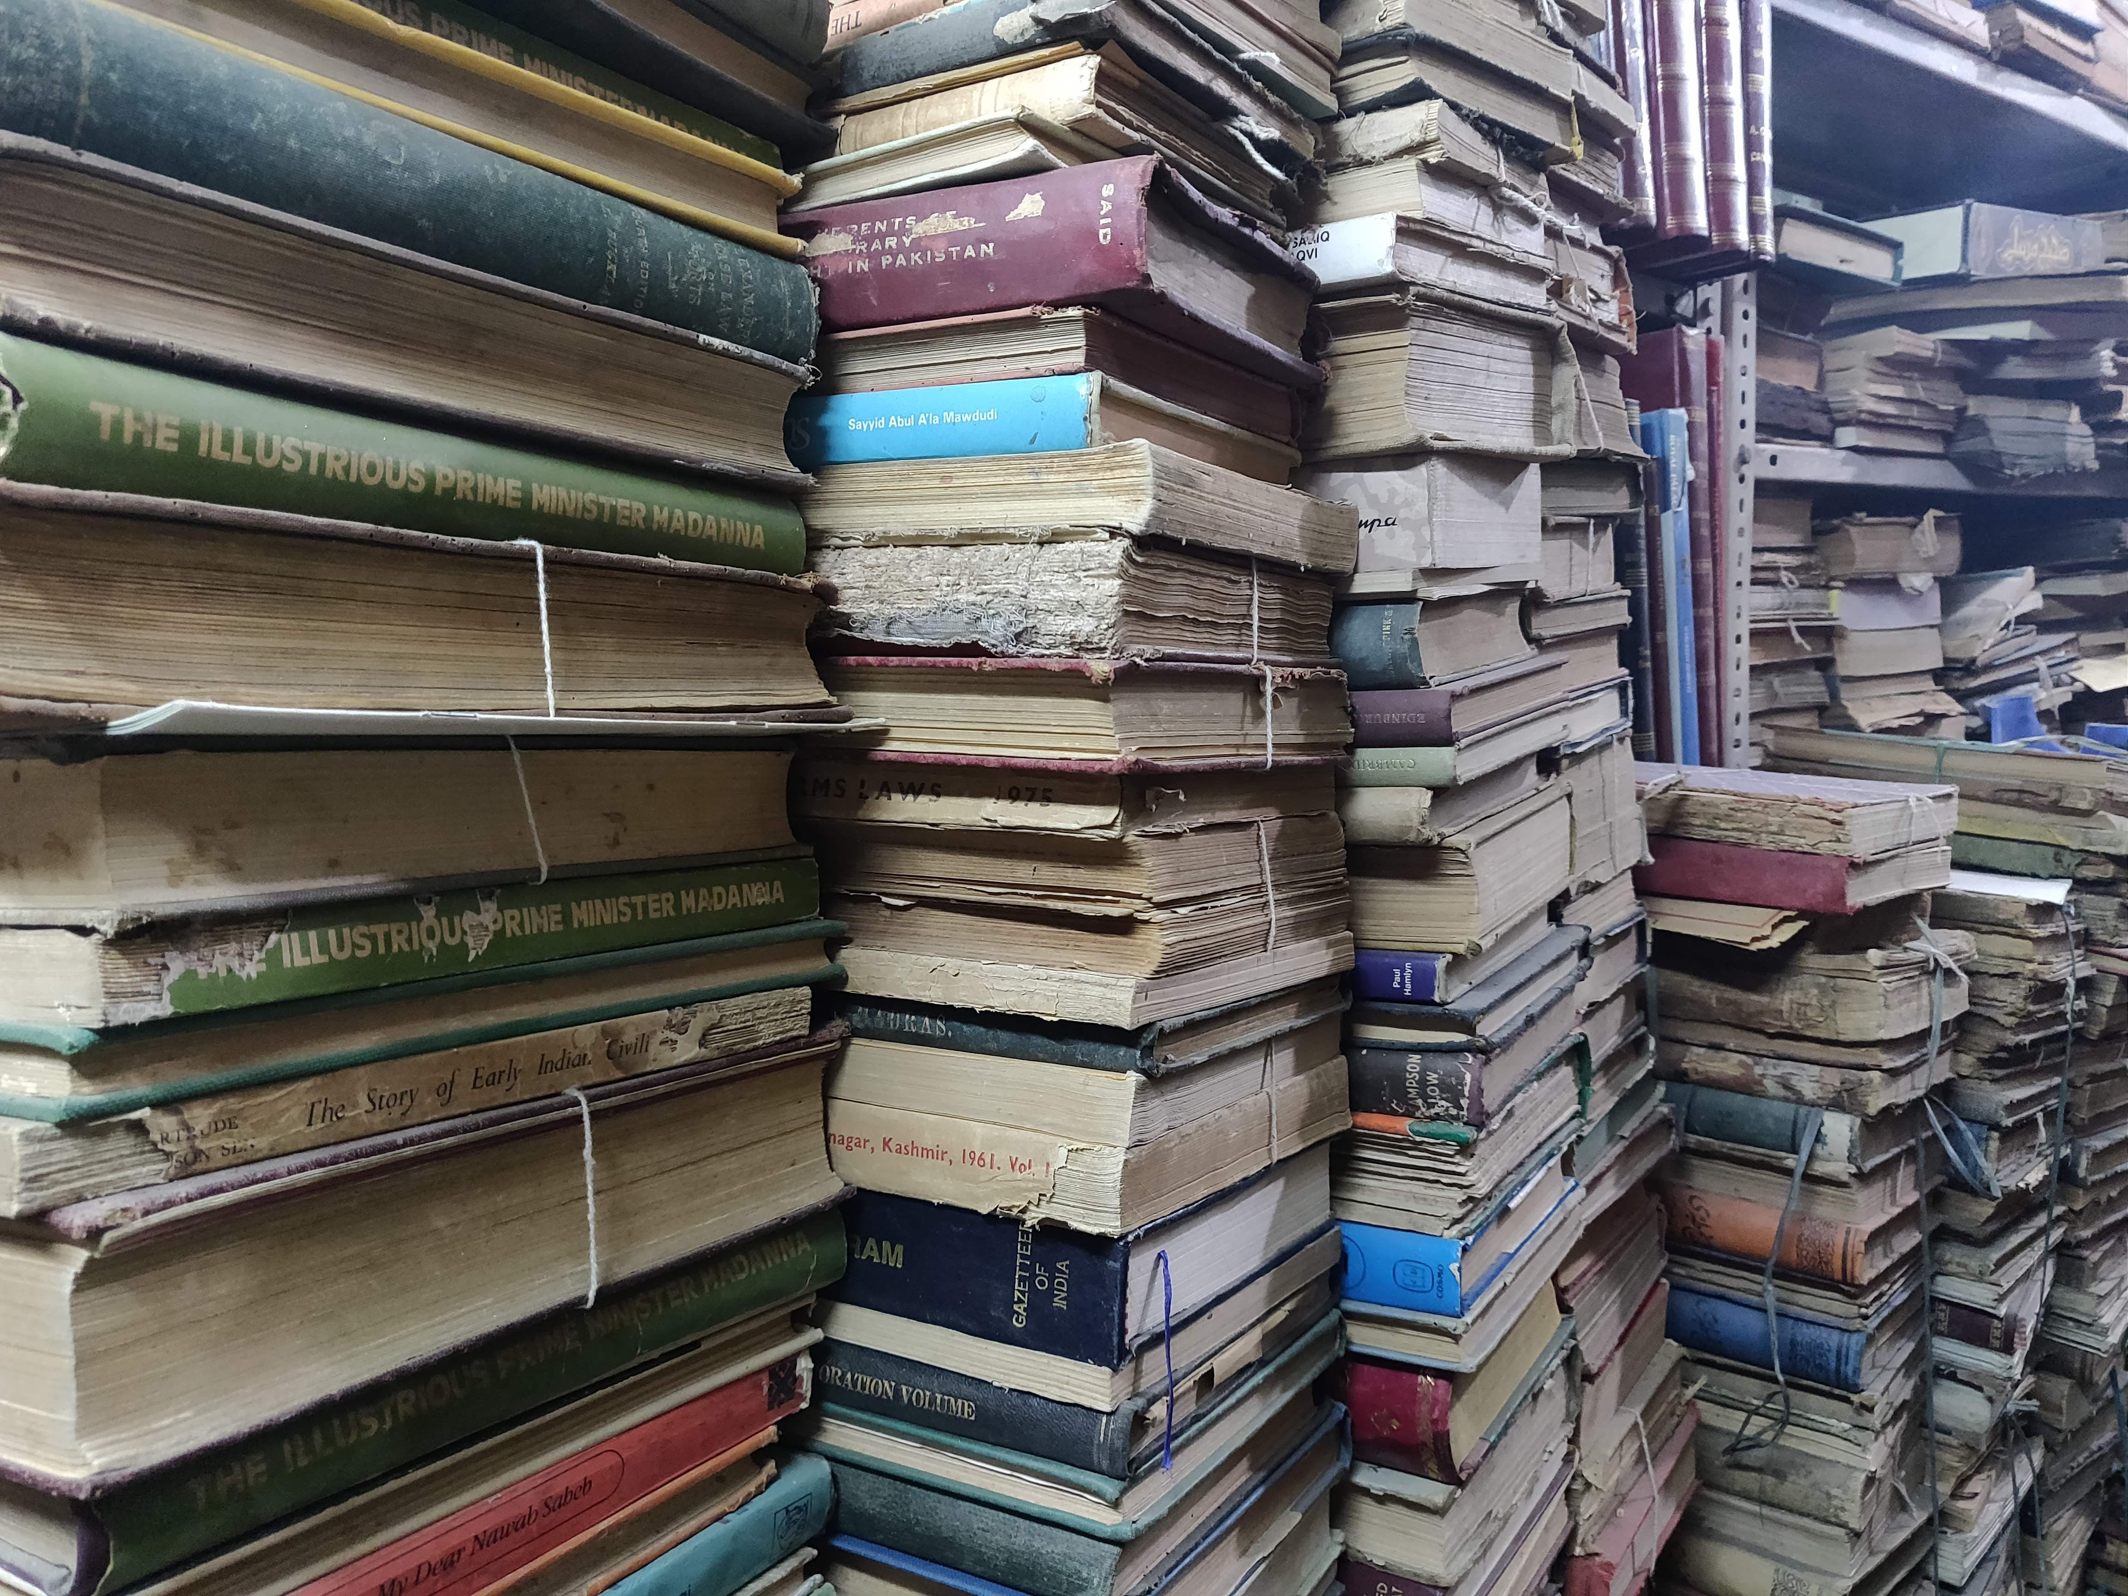
Problem Statement
03
2023
DON’T WASTE OLD BOOKS BY SELLING THEM TO HAWKERS
WASTING OF MONEY IN BUYING NEW BOOKS WHEN OLD ARE AVAILABLE AT LOW PRICES
TO HELP THE STUDENTS WHO ARE UNABLE TO AFFORD EXPENSIVE BOOKS
TO REDUCE PAPER WASTAGE

Slide 4
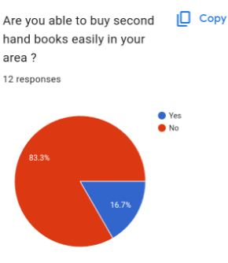
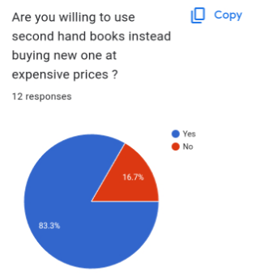
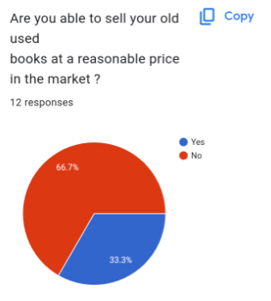
Customer Survey
04
2023
Results of our survey on people facing with the same problems

Slide 5
Problem and solution
05
2023
Problem
Solution
TO MAKE USE OF OLD BOOKS
CREATING A WEBSITE TO BUY AND SELL THEM

Slide 6
Exisisting Solutions
06
2023
Solution 1
Solution 2
BOOKFLOW.IN
USEDBOOKSFACTORY.COM
The above are two of the websites that are for selling books though their main focus is not on second hand books they can still be sold

Slide 7

Product Overview
07
2023
A E-COMMERCE WEBSITE TO HELP THE STUDENTS TO BUY AND SELL THE SECOND HAND BOOKS AT A REASONABLE PRICE
THE PRICE OF SALE IS LOWER THAN THE PRICE OF OFFLINE STORES
PRICES SATISFY BOTH THE BUYER AND SELLER
TO REDUCE THE WASTE OF PAPER

Slide 8
SWOT Analysis
08
2023
HUGE MARKET AUDIENCE
EASY TO ACCESS
CONNECTS SELLER AND BUYER
OPEN TO BUILT
Strengths
Opportunities
Weakness
Threats
LOW EXPOSURE
COMPETITIVE MARKET
Malicious price competition by rival websites
Hard to guarantee initial reputation

Slide 9
Value proposition (Product)
Gain creators
We earn the money by charging a certain cost over each book sold
We can also put a couple of advertisements to earn a money
Products and services
Our project is a student friendly website
We allow students to save money by making proper use of their available books
Pain relievers
The main pain our project relieves is the pain of not knowing what to do with your old and useless books on which you spent a lot of money.

Slide 10
Value proposition (Customers)
Gains
Customer does not need to spend a lot of thought on dealing with books
customer will be able to recover a part of cost put on the book
Customer jobs
Our project is an intermediatory who acts as a platform for the communication of buyers and sellers of second hand books
Pains
Lack of affordable books in undeveloped areas

Slide 11
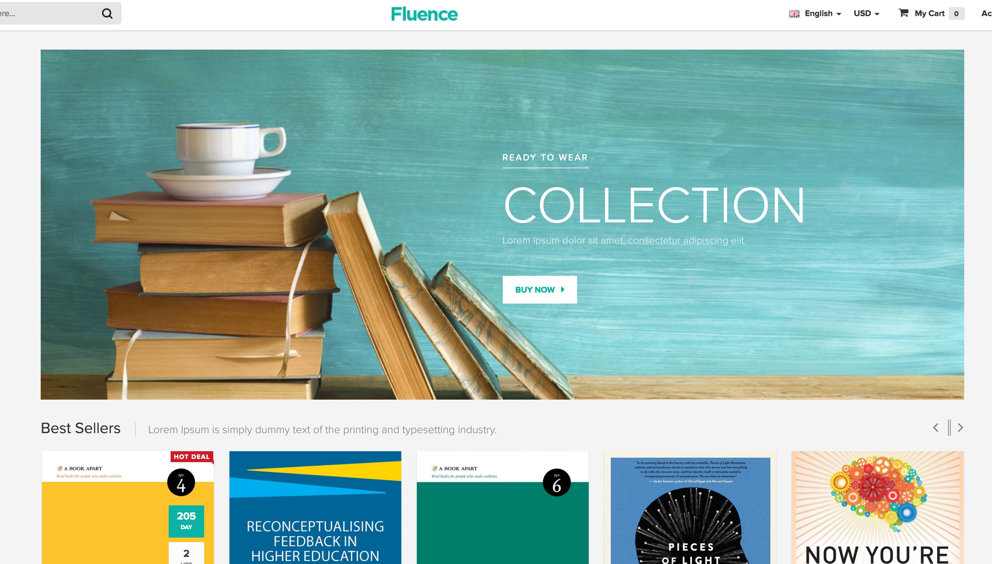
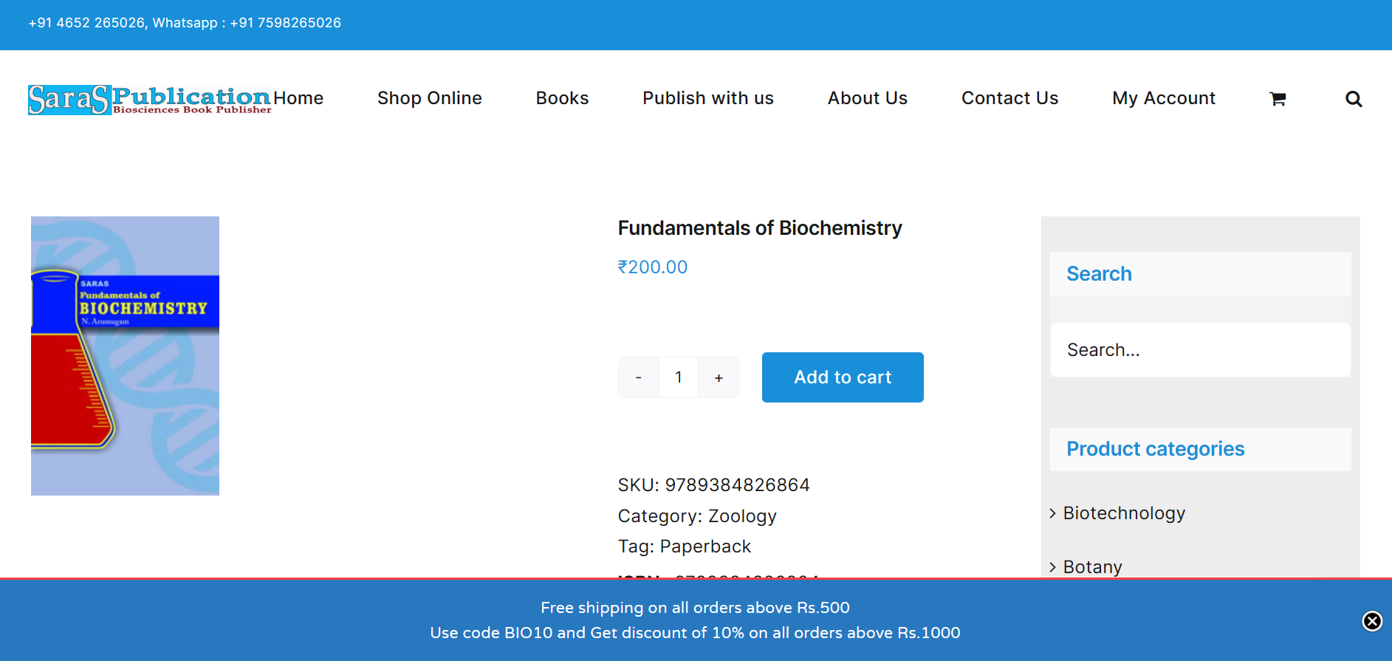
Design Blueprint
09
2023
Above are the model of home page and purchasing page of our website.

Slide 12
Thank You!
2023
Do you have any questions?
Presented by
J.PUNEET –22R21A66985
K.MITHUN – 22R21A6686
K.MOUNESH – 22R21A6692
K.JOSEPH – 22R21A6697

